Slide 1



INTERNSHIP ON
AI-Powered Sales Forcasting and Churn Prediction Dashboard
Under The Guidance Of:
Mr. V. Santhosh, Assistant Professor,
IT Department,CBIT
Presented by
Podichetty Samiksha
160123737021

Slide 2
AGENDA
1.Introduction
2.Internship Overview
3. Introduction
4.Certificate
5.Task 1- AI Powered Sales forcasting dashboard
6.Task 2-Churn Prediction
7.Outcome of the Internship
8.Conclusion
9.Bibliography

Slide 3
INTERNSHIP OVERVIEW
This internship provided hands-on experience in building real-world Machine Learning solutions for business analytics.The work focused on understanding end-to-end ML workflows—from data collection and cleaning to model development, evaluation, and visualization.Through two major projects, the internship strengthened skills in Python programming, data preprocessing, predictive modeling, and interpreting model outputs for business decision-making. The experience demonstrated how ML can be used to forecast future trends, identify customer risks, and support strategic planning across industries.

Slide 4
INTRODUCTION TO TASK 1
AI POWERED SALES FORCASTING DASHBOARD
This internship provided hands-on experience in building real-world Machine Learning solutions for business analytics. The work focused on understanding end-to-end ML workflows—from data collection and cleaning to model development, evaluation, and visualization. Through two major projects, the internship strengthened skills in Python programming, data preprocessing, predictive modeling, and interpreting model outputs for business decision-making. The experience demonstrated how ML can be used to forecast future trends, identify customer risks, and support strategic planning across industries.

Slide 5
INTRODUCTION TO TASK 2
CUSTOMER CHURN PREDICTION SYSTEM
Task 2 focused on developing a machine learning model that predicts which customers are likely to discontinue a service. Using an industry-standard churn dataset, the project involved cleaning and encoding customer attributes, engineering features such as contract type and monthly charges, and training an XGBoost classifier. The model outputs were interpreted through churn probability scores, feature importance metrics, and visual dashboards. This task demonstrated how organizations can use ML to improve customer retention, reduce revenue loss, and understand the key factors driving churn.

Slide 6
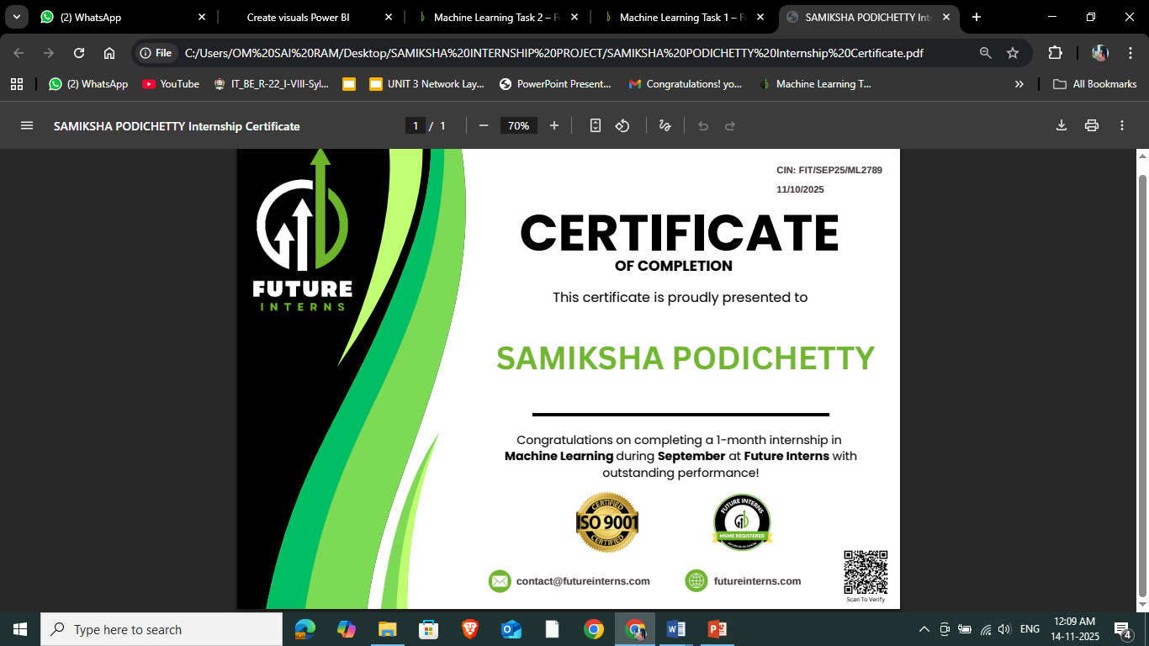
INTERNSHIP CERTIFICATE

Slide 7
TASK 1
AI POWERED SALES FORCASTING DASHBOARD

Slide 8
TECHNOLOGIES USED
1. Python Programming Language:
  Used for data preprocessing, feature engineering, and developing the time-series forecasting model.
2. Pandas & NumPy:
  Data cleaning, transformation, and aggregation
  Handling date-time formats
3. Prophet (Prophet):
  Core forecasting algorithm used in the project
  Generates predicted sales values (yhat)
  Handles seasonality and trend modeling automatically
4. Jupyter Notebook / Google Colab:
  Environment for writing and executing the ML code
  Used for EDA, model training, and generating final forecast results
5. Microsoft Power BI Desktop:
  Dashboard creation and visualization
  Importing forecast output and actual sales

Slide 9
KEY FEATURES
1. Actual vs Forecasted Sales Visualization
Displays historical sales alongside Prophet model predictions, allowing users to compare past performance with future trends.
2. Confidence Interval Forecast Band
Shows upper and lower prediction limits, helping businesses understand possible best-case and worst-case sales scenarios.
3. KPI Cards for Quick Insights
• Total Sales
• Total Profit
• Forecasted Sales
• Quantity Sold
4. Monthly and Yearly Trend Analysis:
Helps identify seasonality, monthly peaks, slow periods, and long-term performance patterns.

Slide 10
5. Region-Wise Sales Breakdown:
Shows which regions generate the highest revenue and how regional performance changes over time.
6. Category-Wise and Sub-Category Insights:
Highlights sales and profit performance across product categories such as Furniture, Office Supplies, and Technology.

Slide 11
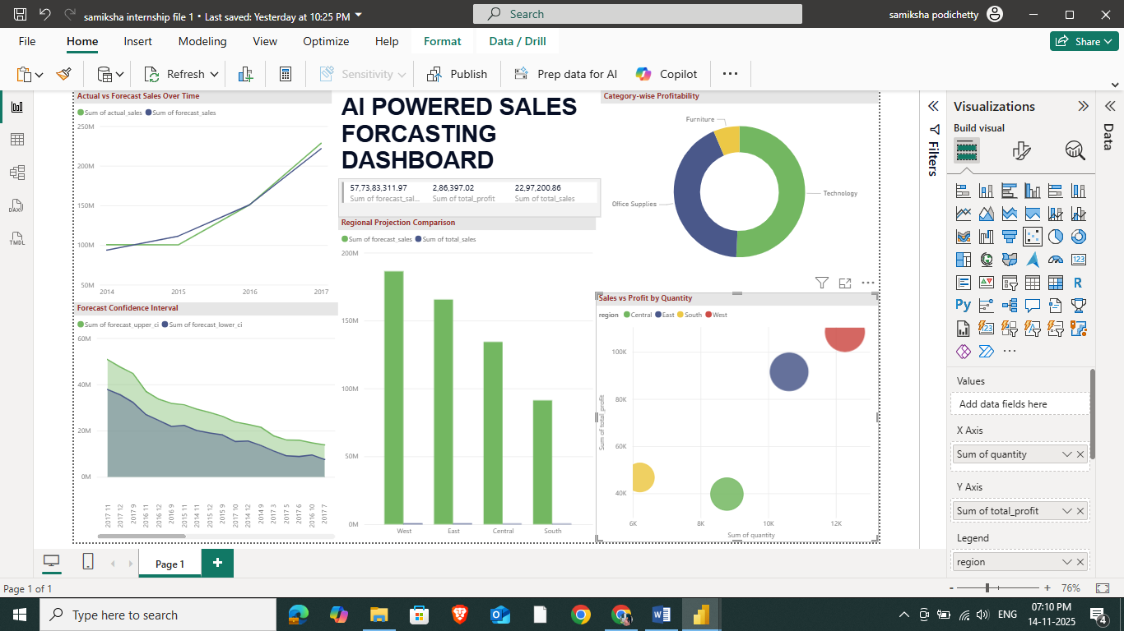
DASHBOARD

Slide 12
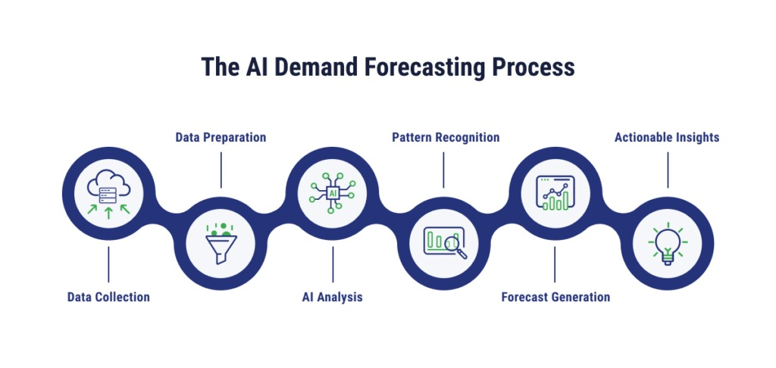
ARCHITECTURE/FLOWDIAGRAM

Slide 13
TASK 2
TELECOM CUSTOMERS CHURN
PREDICTION SYSTEM

Slide 14
TECHONOLOGIES
Programming & Libraries
• Python – core language
• Pandas & NumPy – data preprocessing
• Scikit-learn – encoding, splitting, evaluation metrics
• XGBoost – classification algorithm
• Matplotlib / Seaborn – visual exploration and charts
Tools & Platforms
• Jupyter Notebook / Google Colab – model development
• Power BI or Matplotlib – visualization of model outputs and insights
Machine Learning Concepts Applied
• Classification modeling
• Train-test split
• Overfitting/underfitting awareness
• Churn probability calculation
• Feature importance interpretation

Slide 15
Key Features of the Customer Churn Prediction System (Task 2)
1. Customer Churn Classification Model (XGBoost):
• Predicts whether a customer is likely to churn based on historical patterns.
• Generates churn probability scores for each customer, enabling early intervention.
2. Feature Importance Visualization:
• Identifies the most influential factors driving churn (e.g., tenure, contract type, payment method).
• Helps businesses understand why customers are leaving.
3. Churn Distribution Insights:
• Visual breakdown of churn vs non-churn customers.
• Shows the proportion of customers at risk.
4. Contract Type & Payment Method Analysis:
• Highlights segments with highest churn (e.g., month-to-month contracts, electronic check users).
• Assists in designing targeted retention offers.

Slide 16
5. Monthly Charges and Tenure Pattern Analysis:
• Shows how billing amount and length of service influence churn.
• Useful for pricing strategy and customer support improvements.
6. Actual vs Predicted Churn Comparison:
• Evaluates model accuracy by comparing true customer labels with model predictions.
• Helps validate performance of the XGBoost model.
7. KPI Summary Cards:
• Total Customers
• Total Churners
• Churn Rate (%)
• High-Risk Customers
Provides quick, at-a-glance business metrics.
8. Churn Probability-Based Segmentation:
• Groups customers into Low, Medium, and High churn-risk categories.
• Guides retention teams to prioritize top-risk users.
9. Interactive Filters:
• Filters by contract, tenure, payment method, senior citizen, and more
• Allows personalized and segment-wise churn exploration.

Slide 17
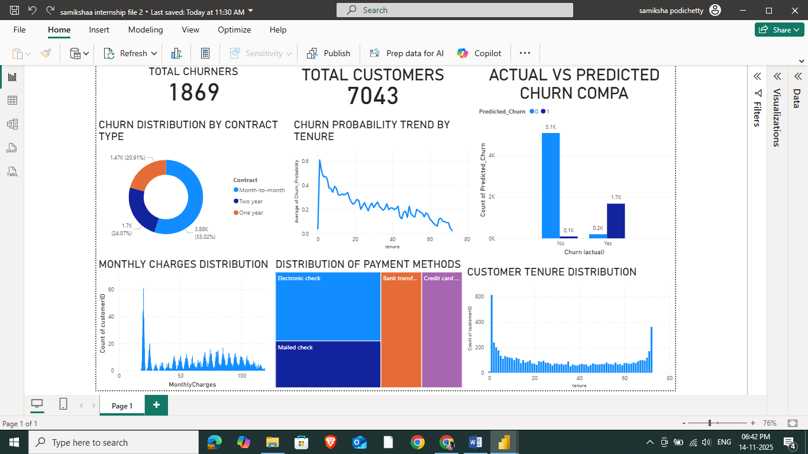
DASHBOARD

Slide 18
OUTCOMES OF THE INTERNSHIP
  Developed practical skills in building real-world machine learning models for forecasting sales and predicting customer churn.
  Gained hands-on experience in data cleaning, preprocessing, feature engineering, and model evaluation using Python and advanced ML libraries.
  Created interactive analytical dashboards in Power BI to communicate insights effectively through visual storytelling.
  Improved understanding of business analytics, including trend analysis, customer behavior interpretation, and data-driven decision-making.
  Strengthened technical reporting and presentation skills by documenting workflows, explaining insights, and presenting outcomes in a structured format

Slide 19
CONCLUSION
  The internship provided valuable hands-on experience in applying machine learning techniques to real business problems, enhancing both technical and analytical skills.
  Building the sales forecasting and churn prediction systems improved understanding of end-to-end ML workflows—from data preparation to model deployment and visualization.
  Working with real datasets strengthened the ability to interpret patterns, generate insights, and transform raw data into actionable business recommendations.
  Developing Power BI dashboards enhanced skills in visual storytelling, helping bridge the gap between technical model outputs and managerial decision-making.
  Overall, the internship contributed significantly to professional growth, preparing for future roles in data science, analytics, and AI-driven problem solving.

Slide 20
BIBLIOGRAPHY
  Prophet Documentation – Meta Open Source.
https://facebook.github.io/prophet/
  XGBoost Documentation – Official Guide.
https://xgboost.readthedocs.io/
  Matplotlib Documentation – Visualization with Python.
https://matplotlib.org/
  Microsoft Power BI Documentation – Dashboard Development.
https://learn.microsoft.com/power-bi/
  Kaggle Datasets – Public datasets for forecasting and churn prediction.

